Slide 1

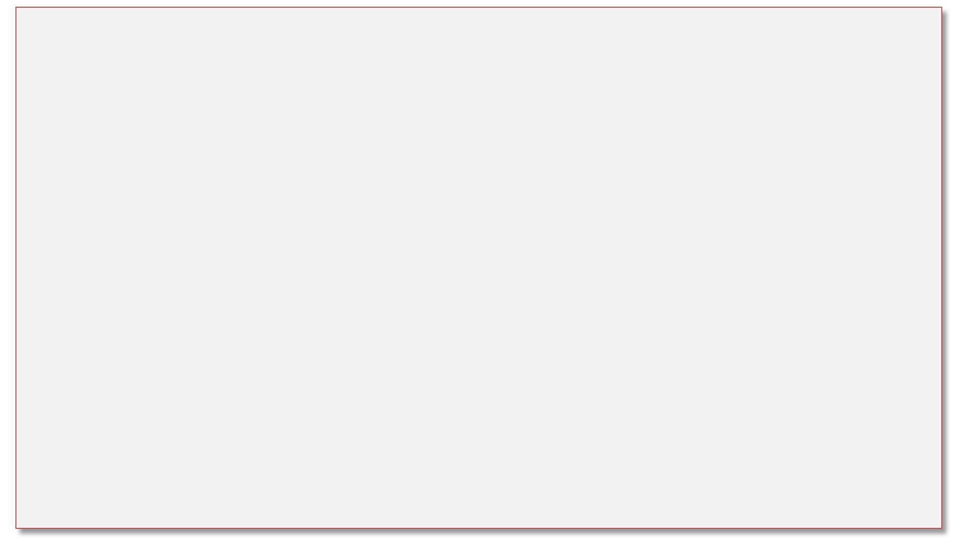
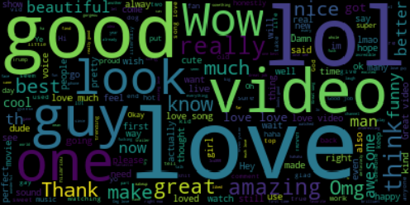
Content Analysis of YouTube Data
cs229,Autumn 2017; Category : Natural Language
Afshin Moin (afshinm), Abhishek Bharani (abharani), and Peng Seng Kuok (pkuok)
Motivation
The popularity of social media is increasing rapidly because it is easy to use and simple to create and share images, video even for users who are technically unaware of social media. You-tube is most popular video sharing with millions of users uploading videos and billions of comments on the videos.
In our project we do Sentiment analysis of the comments, categorize videos based on their comments by predicting it’s category, predict the popularity of the video based on sentiments and ratings given.
Approach
First we use the features extracted like sentiment polarity to train classification methods to decide the polarity of new comment. We ran three different classification techniques on the data like Bernoulli Naïve Bayes and Ridge Classifier and SVM. Analyzing the sentiments from comments helped us to separate positive and negative comments and identify most used words. We used python wordcloud library to generate the wordcloud of positive and negative words.
Second we do category classification to categorize the YouTube videos based on the comments by computing the joint distribution of category and comments.
Approach II : Dimensionality Reduction
Data
We used data from Kaggle competition. https://www.kaggle.com/datasnaek/youtube
Two csv files one containing list of top 200 videos per day. It contains video id , title , channel title , category id , tags, views, likes, dislikes, comment total, thumbnail pic and date it was trending on. Another csv file contains comments for each of the video id, number of likes and replies for each comment.
Sentiment & Category Classification Summary
Model | Acc. (train/test)
Logistic Reg. | 95.64/94.47
RidgeClassifier | 93.98/90.46
Bernoulli NB | 72.15/71.53
Linear SVM | 96.89/95.14
Model | Acc. (train/test)
Logistic Reg. | 60.70/53.21
RidgeClassifier | 65.77/55.91
Bernoulli NB | 45.53/41.61
Linear SVM | 68.95/57.79
Feature Extraction
We extracted features like sentiment polarity using TextBlob. TextBlob provides a consistent API for diving into common natural language processing (NLP) tasks such as part-of-speech tagging, noun phrase extraction, sentiment analysis, and more. TF-IDF, finds frequent words across comments.
Future work
Category classification based on tags
Automatic generation of tags based on category
Generation of automatic comments given category, sentiment and length
References
sklearn, numpy, pandas, TextBlob were used in our development. Our classifiers assumed the default hyperparameters provided by the respective libraries G. Toderici, H. Aradhye, M. Pasca, L. Sbaiz, and J. Yagnik. Finding meaning on youtube: Tag recom- mendation and category discovery. In Computer Vision and Pattern Recognition, 2010.
YouTube. YouTube Database For Kaggle Competitions. https://www.kaggle.com/datasnaek/youtube.

Slide 2

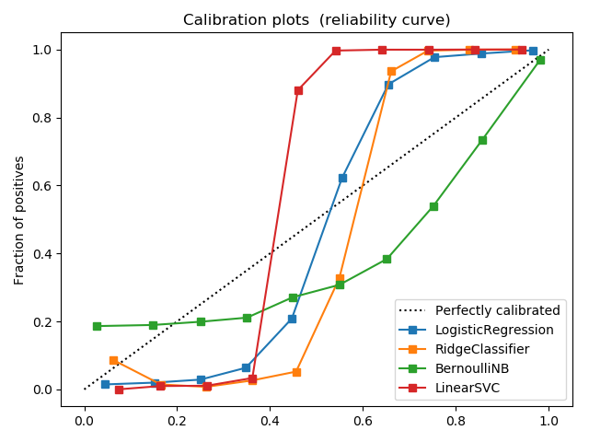
Content Analysis of YouTube Data
cs229,Autumn 2017; Category : Natural Language
Afshin Moin (afshinm), Abhishek Bharani (abharani), and Peng Seng Kuok (pkuok)
Motivation
The popularity of social media is increasing rapidly because it is easy to use and simple to create and share images, video even for users who are technically unaware of social media. You-tube is most popular video sharing with millions of users uploading videos and billions of comments on the videos.
In our project we do Sentiment analysis of the comments, categorize videos based on their comments by predicting it’s category, predict the popularity of the video based on sentiments and ratings given.
Data
We used data from Kaggle competition which contains top 200 videos per day along with their comments ,category and tags.
https://www.kaggle.com/datasnaek/youtube
Feature Extraction
We extracted features like sentiment polarity using TextBlob. TextBlob provides a consistent API for diving into common natural language processing (NLP) tasks such as part-of-speech tagging, noun phrase extraction, sentiment polarity, and more. TF-IDF, finds frequent words across comments.
Approach I
First we use the features extracted like sentiment polarity to train classification methods to decide the polarity of new comment. We ran three different classification techniques on the data like Bernoulli Naïve Bayes and Ridge Classifier and SVM. Analyzing the sentiments from comments helped us to separate positive and negative comments and identify most used words. We used python wordcloud library to generate the wordcloud of positive and negative words.
Second we do category classification to categorize the YouTube videos based on the comments by computing the joint distribution of category and comments.
Approach II : Dimensionality Reduction
Sentiment Classification Summary
Category Classification Summary
Model | Acc. (train/test)
Logistic Reg. | 95.64/94.47
Ridge Classifier | 93.98/90.46
Bernoulli NB | 72.15/71.53
Linear SVM | 96.89/95.14
Model | Acc. (train/test)
Logistic Reg. | 60.70/53.21
Ridge Classifier | 65.77/55.91
Bernoulli NB | 45.53/41.61
Linear SVM | 68.95/57.79
Future work
Category classification based on tags
Automatic generation of tags based on category
Generation of automatic comments given category, sentiment and length
Logistic regression returns well calibrated results between range 0 to 1. Bernoulli NB tends to push results to 0 or 1 due to independence assumption which does not hold true here. Ridge Classifier and SVM are partially calibrated between range 0 to 1.
Bag of positive words extracted from comments
References
sklearn, numpy, pandas, TextBlob were used in our development. Our classifiers assumed the default hyperparameters provided by the respective libraries
G. Toderici, H. Aradhye, M. Pasca, L. Sbaiz, and J. Yagnik. Finding meaning on youtube: Tag recom- mendation and category discovery. In Computer Vision and Pattern Recognition, 2010.

